Slide 1



MERN STACK EXPENSE TRACKER
Comprehensive Personal & Family Finance Management
Presented By :
Rohit Jain
Saurabh Chaudhary
Ritik Yadav
Raja

Slide 2

PROJECT OVERVIEW
The MERN Stack Expense Tracker is a comprehensive personal and family finance management application. Its core objective is to help individuals and families efficiently manage income, expenses, budgets, and savings — all in one unified platform. Designed for ease of use, the app provides real-time financial insights, automation of recurring entries, and collaborative tools for shared household finance management.
Target users include individuals seeking better control over personal spending and families aiming for collaborative financial planning. Key benefits include real-time dashboards with actionable insights, automated transaction tracking, multi-user collaboration, detailed analytics across income and expense categories, and robust export capabilities — empowering smarter financial decisions every day.

Slide 3

TECHNOLOGY STACK
MongoDB & Express.js: MongoDB provides a flexible, document-based database for storing all financial data including transactions, budgets, and user profiles. Express.js serves as the backend API framework, delivering a robust and scalable RESTful server architecture.
React.js: A powerful frontend library used to build a responsive, dynamic single-page application. Features a modern dashboard UI with real-time updates, modular components, and intuitive navigation for seamless user experience.
Node.js: The server-side JavaScript runtime powering the entire backend. Enables efficient asynchronous, event-driven operations to handle multiple concurrent users and real-time financial data processing with high performance.

Slide 4
LOGIN DASHBOARD
Clean and modern finance management interface.
Secure login with email and password.
Google Sign-In for quick authentication.
"Forgot Password" and password reset options.
Email & Mobile OTP verification for enhanced security.
Remember Me option for seamless access.

Slide 5
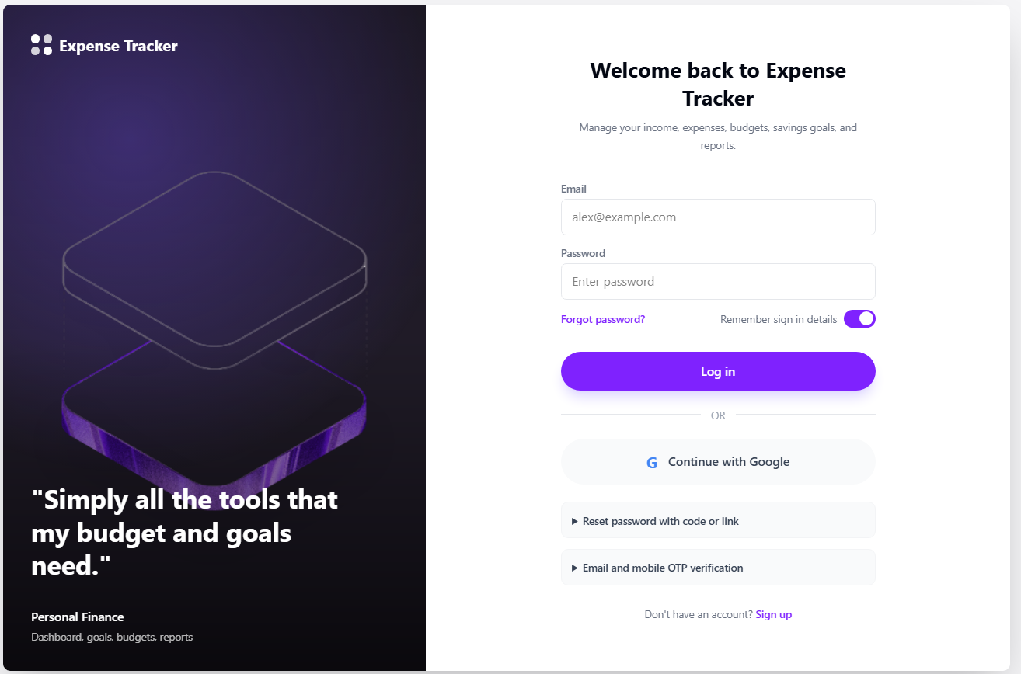

Slide 6
USER REGISTRATION
Complete account registration form.
Collects user details:
Full Name
Phone Number
Country
Email
Password
Currency

Slide 7
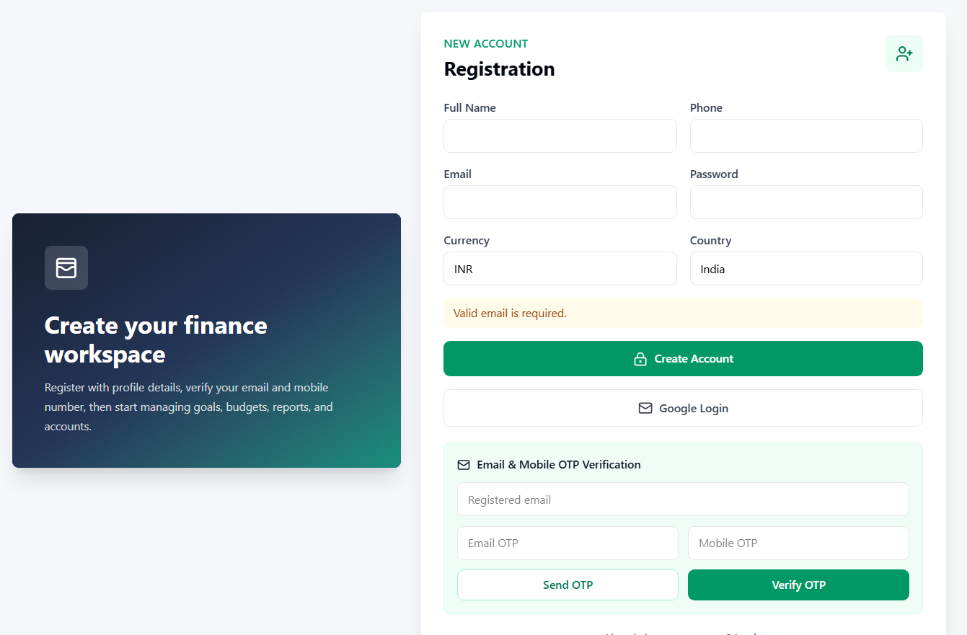

Slide 8
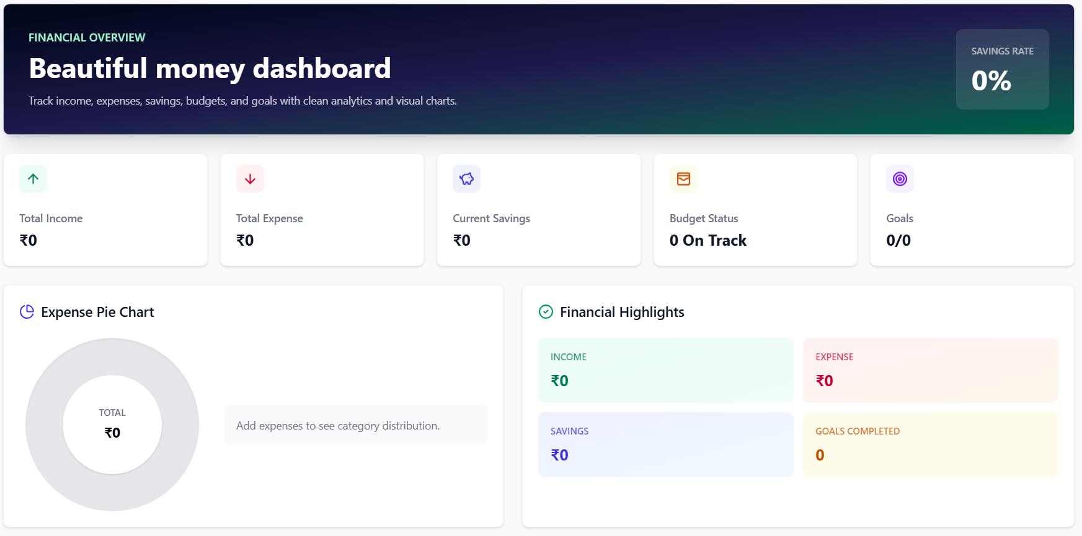
FINANCIAL OVERVIEW
The Financial Overview Dashboard provides a real-time snapshot of your complete financial health. Key metrics include Total Income, Total Expenses, Net Savings, and Budget Status — all displayed in a clean, intuitive layout for quick decision-making.
An interactive expense pie chart breaks down spending by category, while the Financial Highlights panel surfaces top insights. Goals On Track indicators help users stay aligned with their savings targets at a glance.

Slide 10
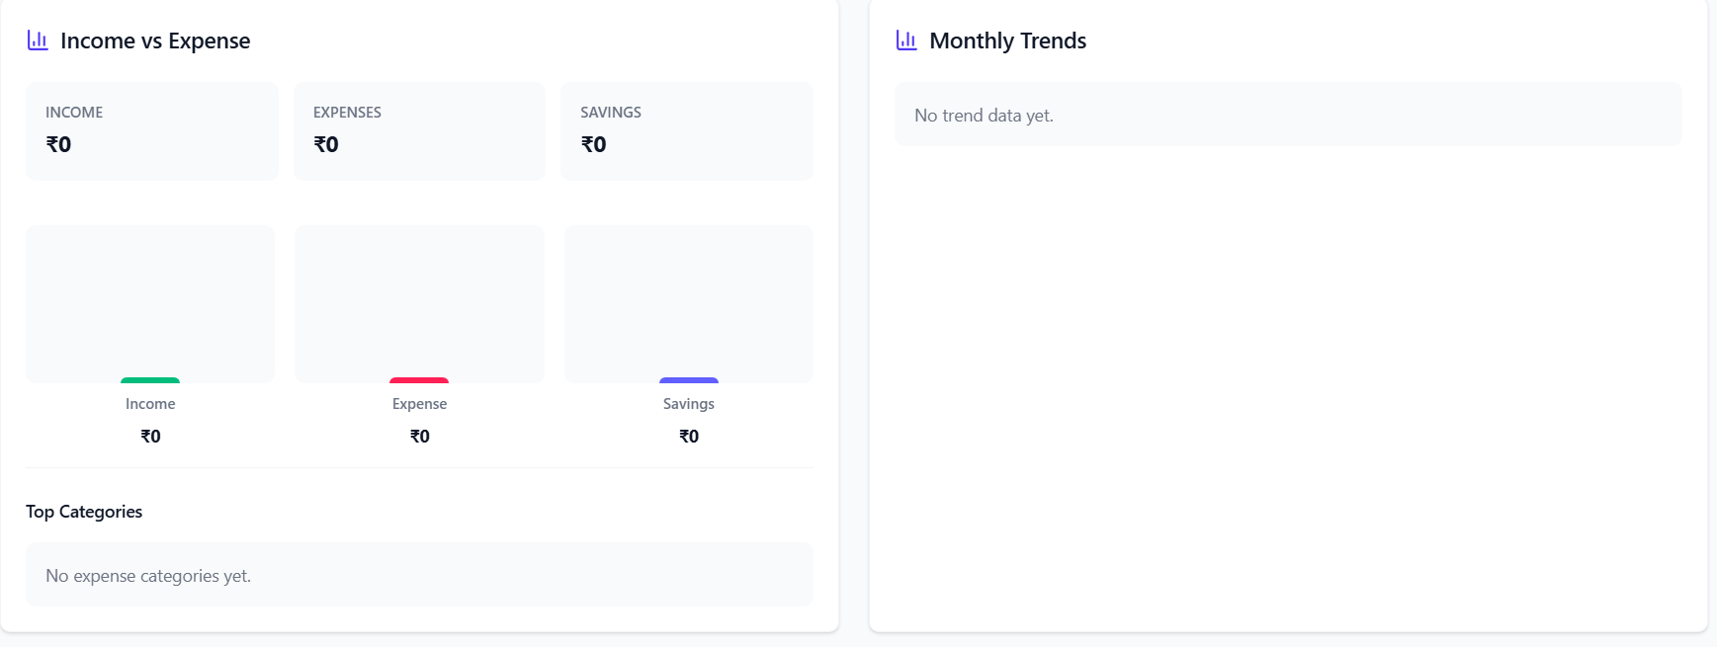
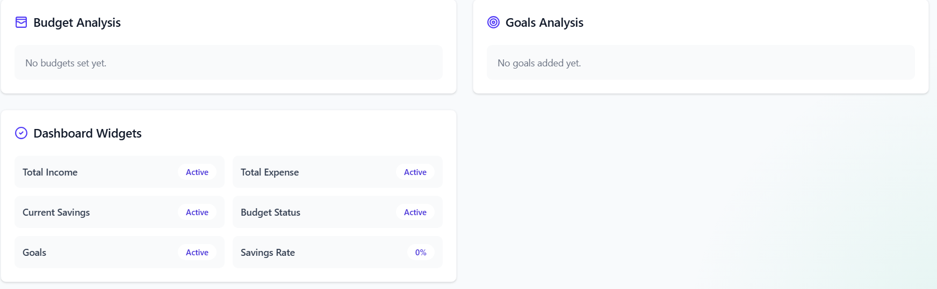

Slide 11
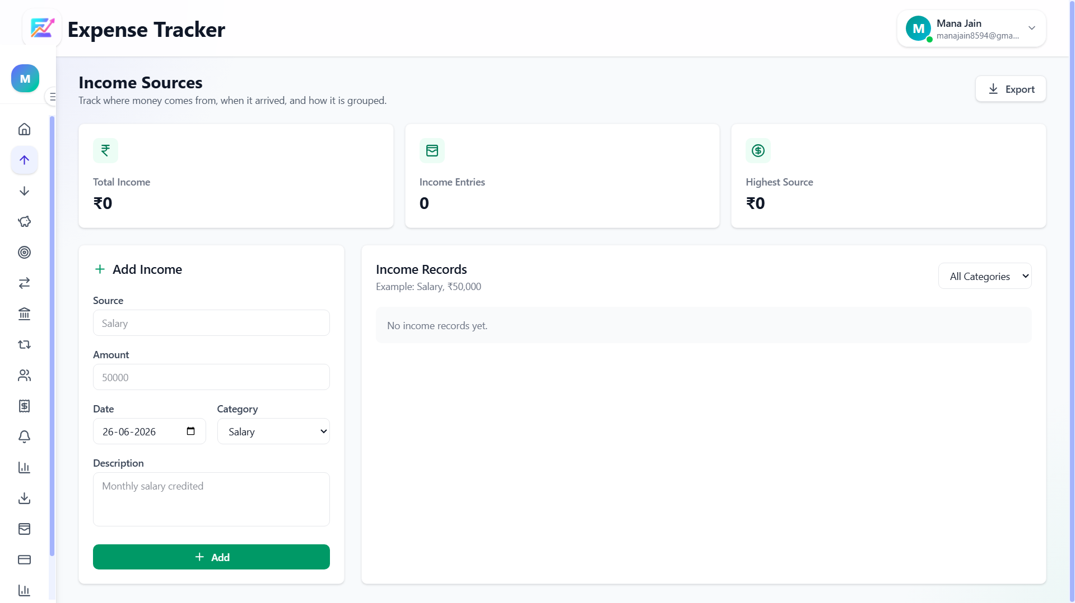
INCOME SOURCES MANAGEMENT
• Add income entries by source, amount, date, category, and description
• View total income at a glance with a clear summary dashboard
• Track number of income entries and identify the highest income source
• Categorize income streams for better financial clarity
• Filter and search income records by date, category, or source
• Monitor income trends over time to plan budgets effectively
• Support for multiple income types: salary, freelance, investment, and more
• Real-time updates ensure accurate and up-to-date income tracking

Slide 13
INCOME VS EXPENSE ANALYSIS
• Monthly Trends: Visual charts comparing income and expenses month-over-month to identify patterns and seasonal fluctuations in your finances.
• Top Spending Categories: Breakdown of where money is being spent most, helping prioritize budget adjustments.
• Savings Opportunities: Identify gaps between income and expenses to uncover actionable savings potential each month.
• Pattern Recognition: Spot recurring overspending trends and make informed decisions to improve your overall financial health.

Slide 15
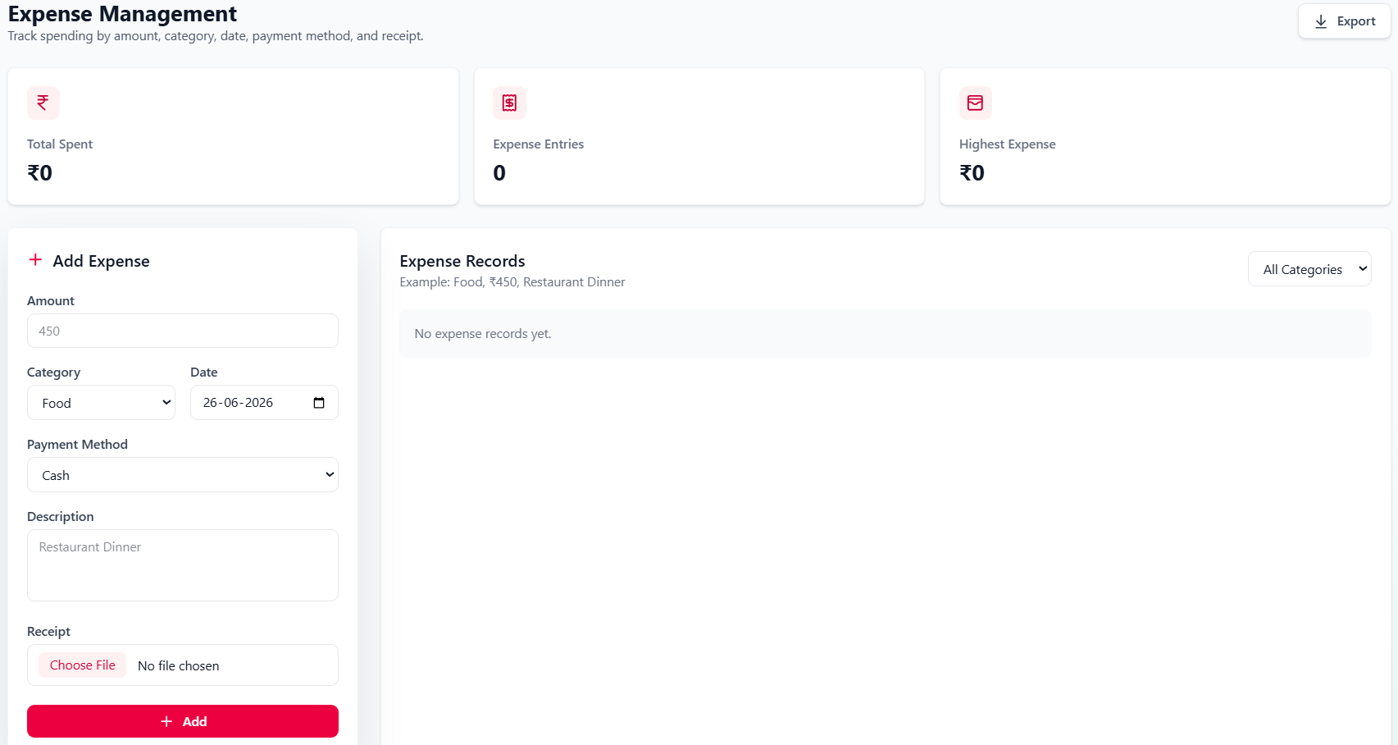
EXPENSE
MANAGEMENT
Track every expense with precision. Add expenses by entering the amount, category, date, payment method, and description. Supports multiple payment types including cash, card, and digital wallets for complete financial visibility.
View total amount spent, identify highest expense entries, and browse your full expense records. Filter and search through past expenses to monitor spending habits and stay within your financial limits.

Slide 17
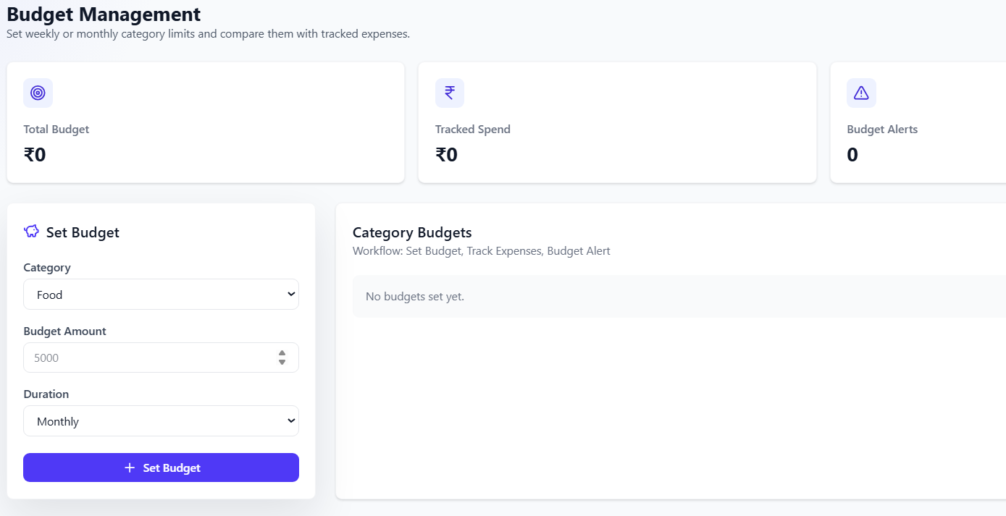
BUDGET MANAGEMENT
Define budget amounts and periods to stay on track with your spending goals.
Set budgets by category (e.g., Food, Transport, Utilities)
Choose weekly or monthly budget periods
Real-time tracking of spending against each budget
Instant alerts when budget limits are breached
Monitor all active budgets from a single dashboard view.
Visual progress bars showing budget utilization
Color-coded indicators: green (safe), amber (near limit), red (exceeded)
Historical budget performance for better planning
Adjust budget amounts anytime to reflect changing needs

Slide 19
BUDGET ANALYSIS
& GOALS
Dashboard widgets summarising budget status and savings rate across all categories, with visual indicators for budgets on track, approaching limits, or breached for immediate awareness.
Goals analysis panel for tracking completion progress of each savings goal, including percentage achieved, remaining amount, and target date — enabling smarter financial planning.

Slide 21
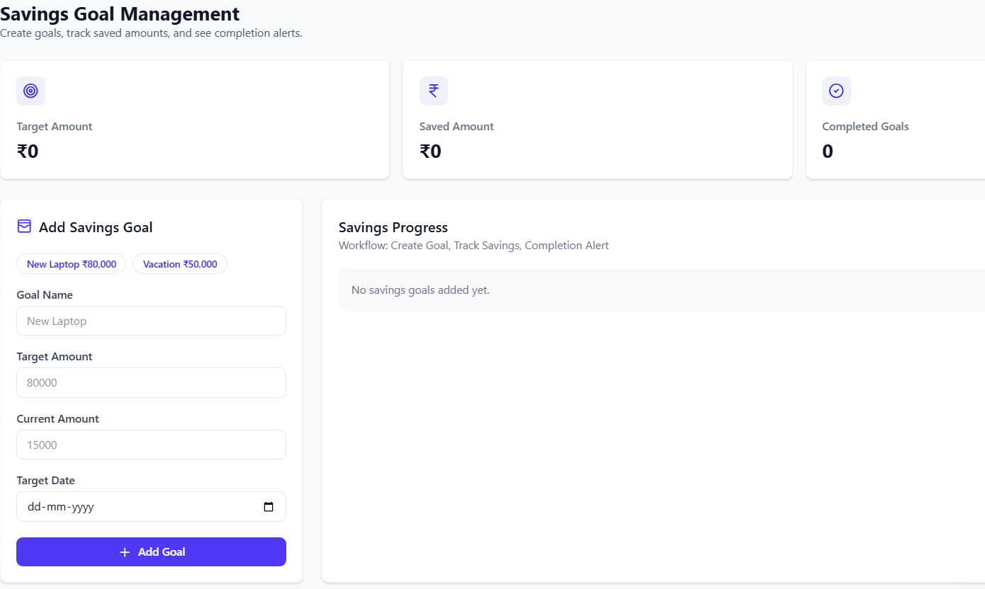
SAVINGS GOAL MANAGEMENT
• Set personalized savings goals with a goal name, target amount, current progress, and target date
• Visual progress tracking shows how close you are to achieving each goal
• Easily update contributions and monitor milestones in real time
• Automated alerts notify you upon goal completion or when deadlines approach
• Reminders keep you on track with consistent saving habits
• Manage multiple goals simultaneously for short-term and long-term financial planning

Slide 23
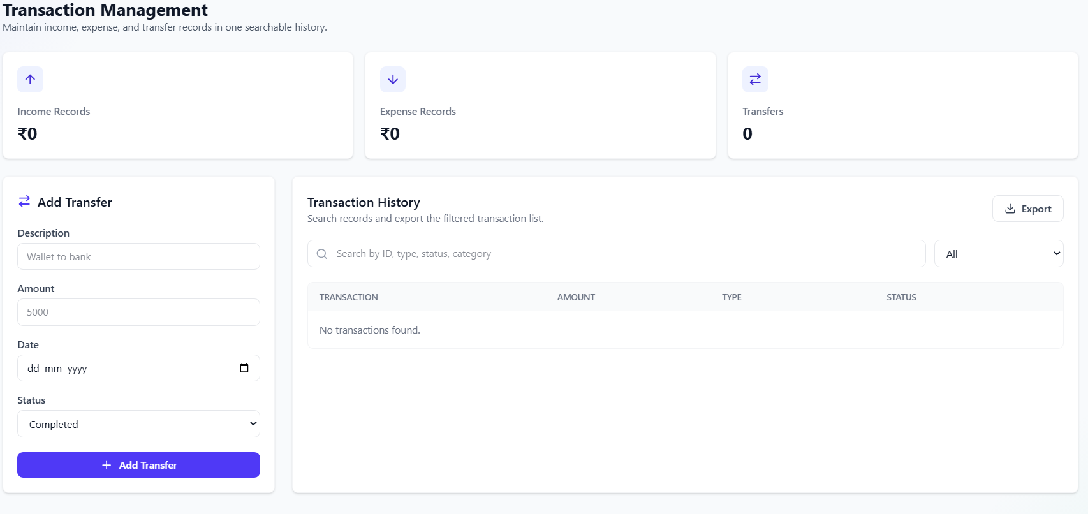
TRANSACTION MANAGEMENT
Manage all income, expense, and transfer transactions in one place. Add transfers with date, amount, description, and status to keep your financial records complete and accurate.
Access a fully searchable history of all transactions — income, expenses, and transfers. Filter, review, and audit your complete financial activity for better transparency and control.

Slide 25
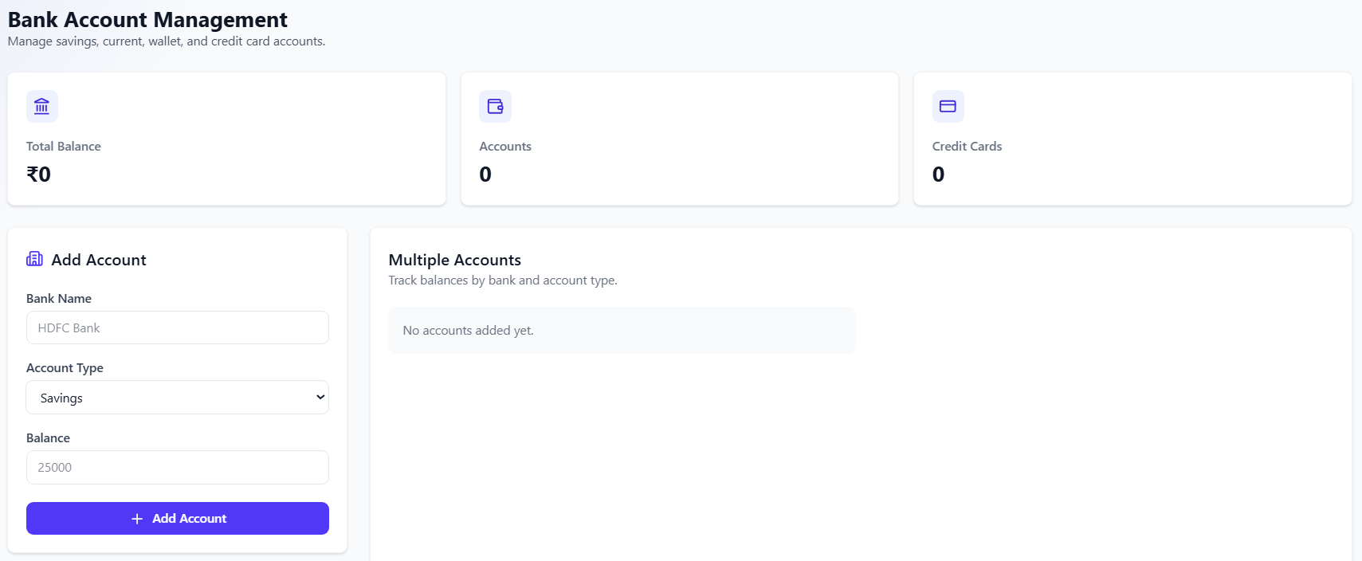
BANK ACCOUNT
MANAGEMENT
• Add multiple bank accounts and credit cards with bank name, account type, and current balance
• View aggregated total balance across all linked accounts at a glance
• Organized account listing for easy monitoring and management
• Supports various account types including savings, checking, and credit cards
• Real-time balance updates as transactions are recorded
• Seamlessly integrates with transfers, expenses, and income tracking for accurate financial data

Slide 27
ACCOUNT TRANSFER SYSTEM
Seamlessly transfer money between your linked bank accounts and credit cards within the app.
• Select source (From) and destination (To) accounts from your registered accounts
• Enter transfer amount, date, description, and current status
• Track all inter-account transfers for accurate balance reconciliation
• Maintain a complete transfer history for full financial transparency
• Supports multiple account types: savings, current, and credit cards

Slide 28
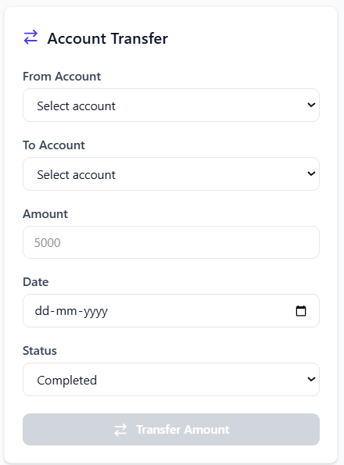

Slide 29
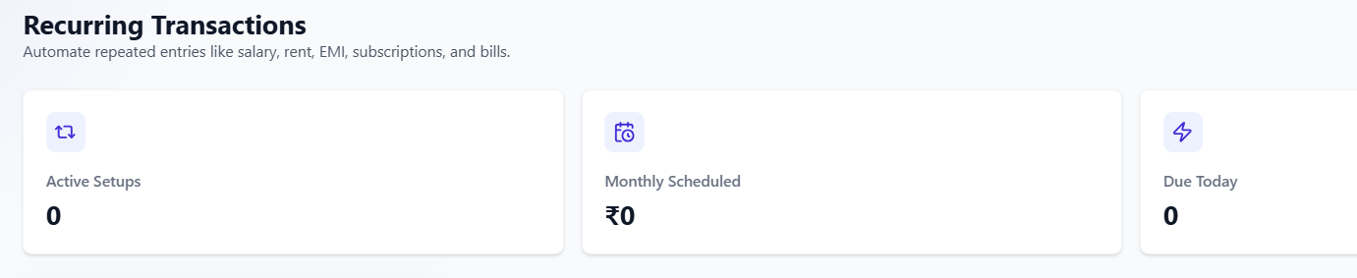
RECURRING TRANSACTIONS OVERVIEW
• Active setups: View all recurring entries currently configured and running automatically
• Monthly scheduled amounts: Track total recurring income and expenses planned each month
• Due transactions: Get timely alerts for upcoming recurring entries to avoid missed payments
• Automate repeated entries like salary, rent, utility bills, and subscriptions effortlessly
• Saves time by eliminating manual re-entry of regular financial transactions
• Ensures financial consistency and accuracy across all accounts and reports

Slide 31
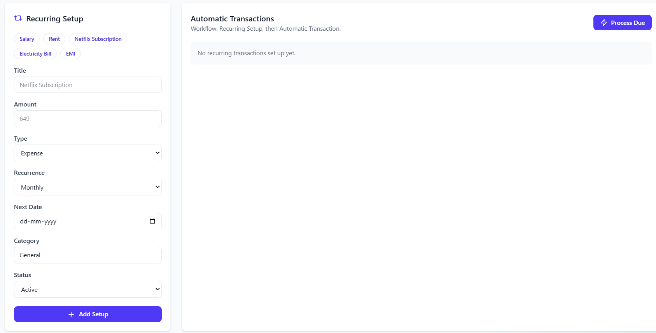
RECURRING TRANSACTION SETUP
Configure new recurring payments or incomes with ease:
• Define title, amount, and transaction type
• Set recurrence frequency (daily, weekly, monthly)
• Specify next scheduled date and category
Automate your financial entries effortlessly:
• Set transaction status (active/inactive)
• Manage automatic posting of recurring transactions
• Reduces manual entry and ensures consistency

Slide 33
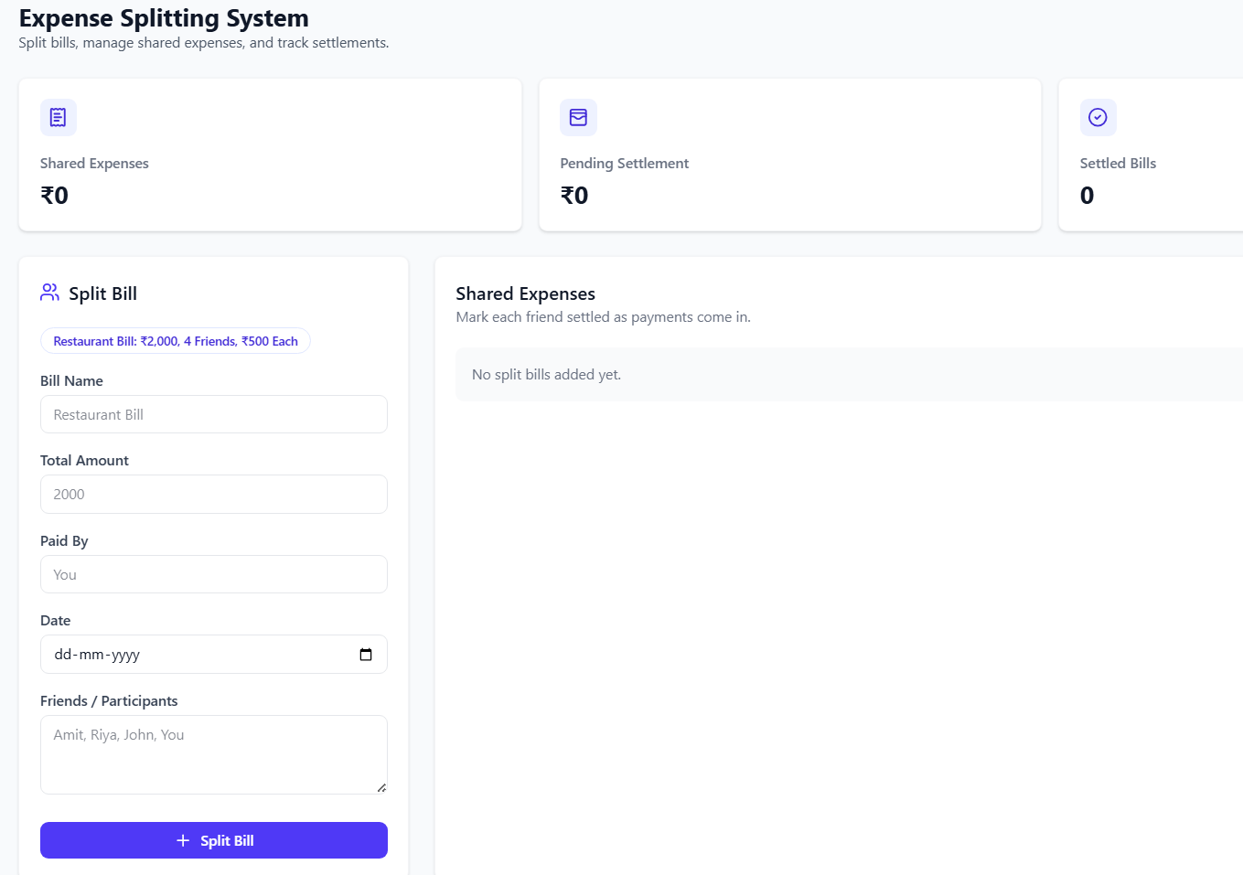
EXPENSE SPLITTING SYSTEM
• Create split bills with participants, amounts, and payment tracking
• Manage settled and pending shared expenses for full transparency
• Assign shares to each participant with flexible split options
• Track who has paid and who owes for each shared expense
• View split history and outstanding balances at a glance
• Simplifies cost sharing among friends and family members

Slide 35
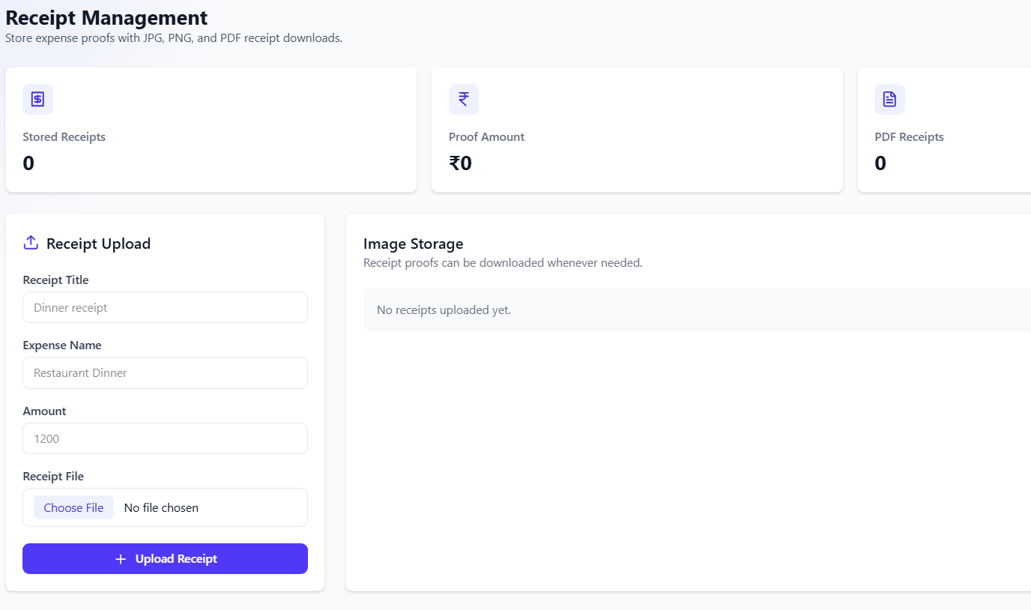
RECEIPT MANAGEMENT
Upload and store proofs of expenses with ease:
• Upload receipts with titles, expense names, amounts, and files
• Attach receipts directly to expense entries for full traceability
• Organize receipt records with searchable history
Access and manage your stored receipts anytime:
• View all uploaded receipts in a centralized receipt library
• Download receipts as PDFs for record-keeping or sharing
• Simplifies auditing, tax filing, and expense verification

Slide 37
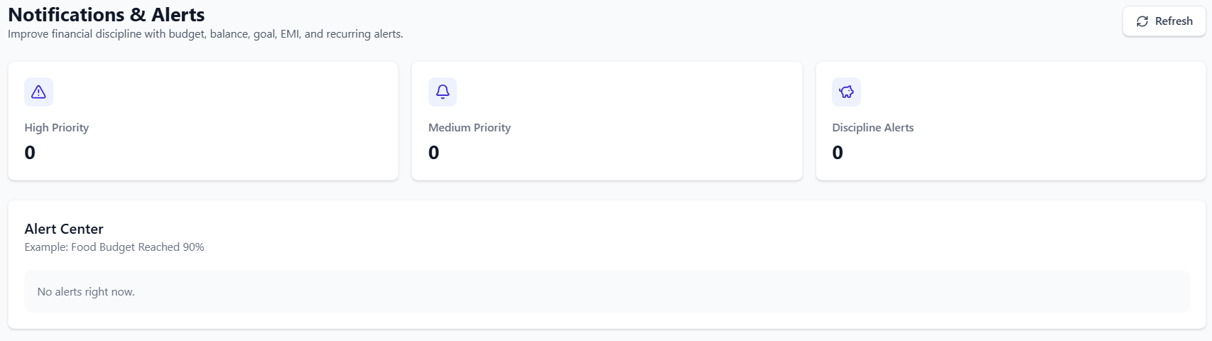
NOTIFICATIONS
& ALERTS
• Budget breach warnings notify users instantly when spending exceeds defined limits, helping prevent overspending across categories.
• Savings goal reminders keep users on track with personalized alerts as target dates approach or progress stalls.
• EMI and bill due alerts ensure timely payments by notifying users ahead of scheduled recurring transactions.
• Alert center overview prioritizes notifications by importance, giving users a clear and organized view of all active financial alerts.

Slide 39
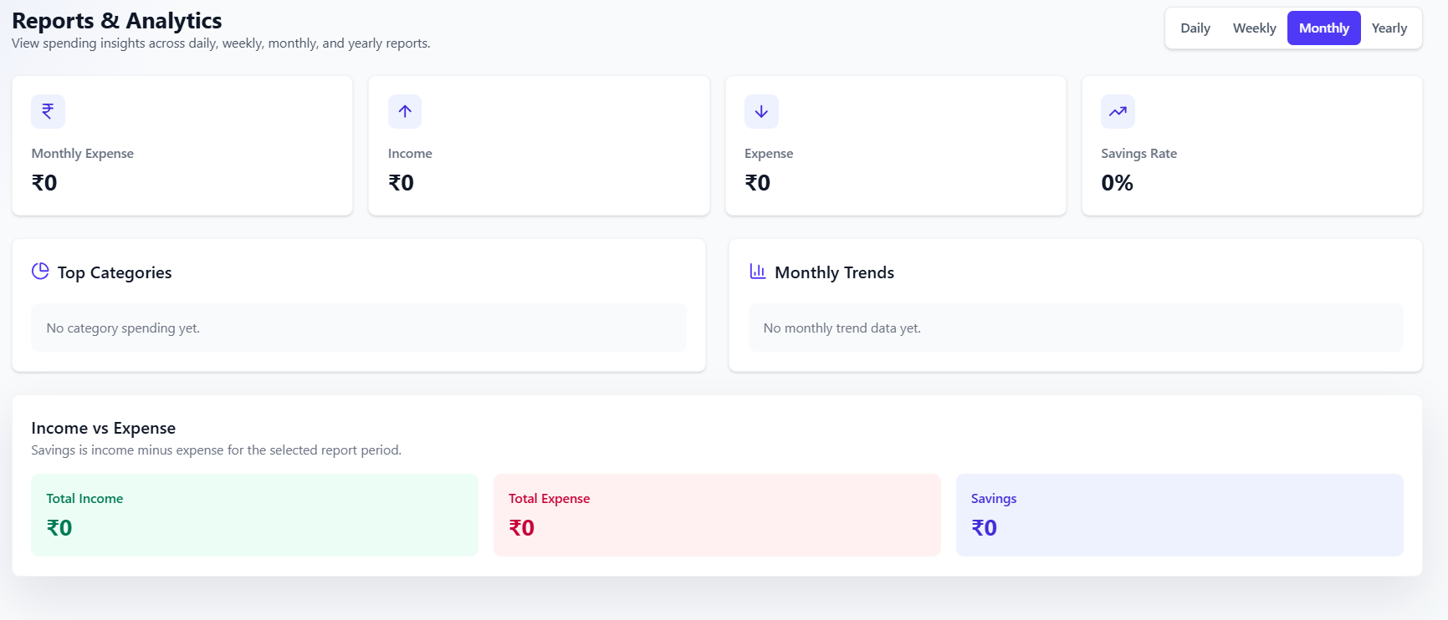
REPORTS &
ANALYTICS
Comprehensive financial analysis across multiple timeframes — daily, weekly, monthly, and yearly summaries give users a complete picture of their financial health at any point in time.
Gain insights into top spending categories, monthly income vs. expense trends, and savings rate performance. Identify patterns and make informed decisions to optimize your financial strategy.

Slide 41
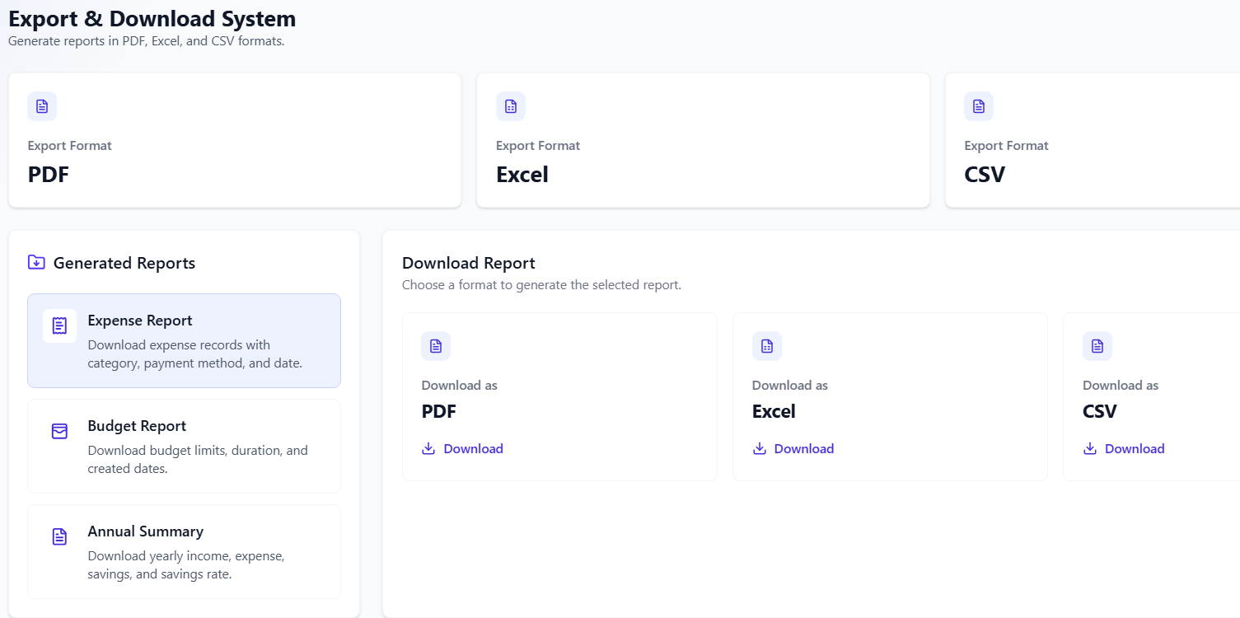
EXPORT & DOWNLOAD SYSTEM
Generate and download detailed financial reports in multiple formats:
• Export formats: PDF, Excel, and CSV for maximum flexibility
• Available reports: Expense Report, Budget Report, and Annual Summary
• Convenient downloads for easy sharing or record-keeping
Key capabilities of the export system:
• One-click report generation across all financial categories
• Customizable date ranges for targeted reporting
• Professional formatting suitable for accountants and advisors
• Instant download with organized file naming conventions

Slide 43
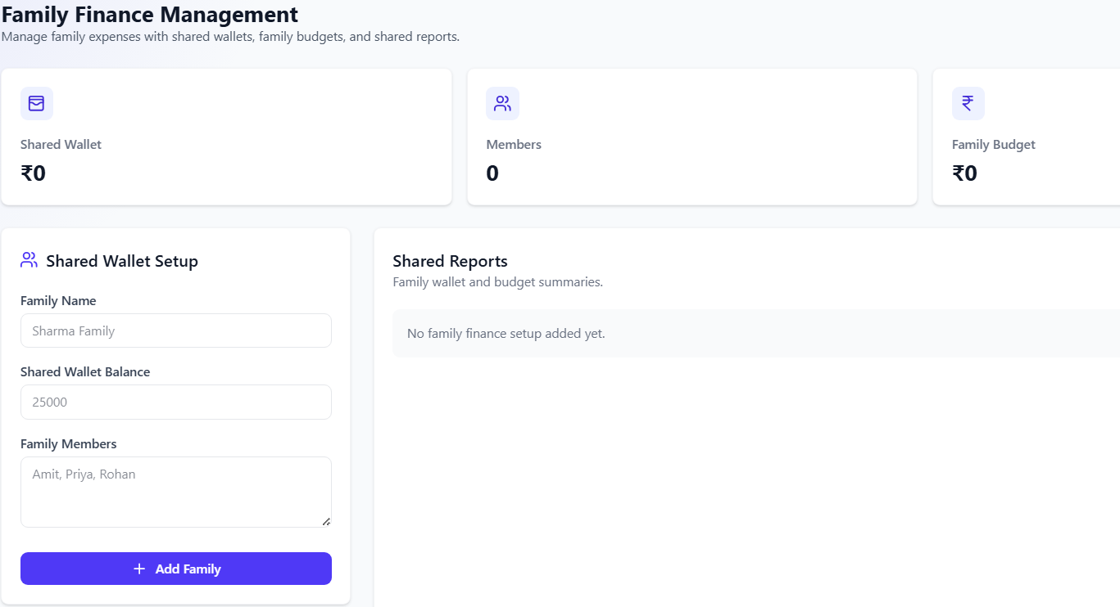
FAMILY FINANCE
MANAGEMENT
• Shared wallet balances visible to all family members for full financial transparency
• View total family balance, active members, and shared spending in one central hub
• Collaborative tracking ensures every member stays informed and aligned on finances
• Family budgets set by category to control collective expenses like groceries or utilities
• Add or remove family members easily and manage roles within the shared wallet
• Real-time updates keep all members synchronized on spending and budget status

Slide 45
FAMILY WALLET SETUP
Create and manage shared family wallets to centralize household finances in one place.
• Define family name, shared balance, and member roles for collaborative tracking
• Add or remove members easily to keep the family group up to date
• Shared wallet provides a unified view of collective balances and contributions
• Enables transparent money management across all family members
• Central hub for coordinating family income, expenses, and budgets seamlessly

Slide 46
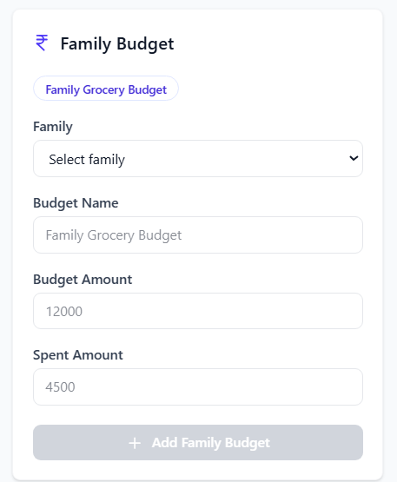
FAMILY BUDGET
MANAGEMENT
Create and manage budgets for your family group to keep collective spending on track:
• Create family budgets with names, amounts, and spending categories
• Monitor budget utilization across all family members in real time
• Control collective expenses like groceries, utilities, and entertainment
• Set spending limits per category to prevent budget overruns
• Receive alerts when family budgets are nearing their limits
• Transparent budget visibility for all family members ensures accountability and smarter financial decisions together

Slide 48
USER INTERFACE HIGHLIGHTS
Modern Dashboard Design
Intuitive dashboard cards display key metrics at a glance — total income, expenses, savings, and budget status. Charts and graphs use purple/blue accent colors for clear visual hierarchy. Clean forms and modals ensure effortless data entry across all features.
Responsive & Accessible UI
Built with React.js for a seamless single-page experience on desktops, tablets, and mobile devices. Consistent component design, smooth navigation, and adaptive layouts ensure every user enjoys a polished, professional interface on any screen size.

Slide 49
BACKEND ARCHITECTURE
Express.js & RESTful APIs
A robust Express.js server powers the backend with well-structured RESTful API endpoints. Each resource — income, expenses, budgets, goals, and accounts — is served through dedicated routes with middleware for authentication, validation, and error handling. The modular architecture ensures scalability and maintainability across all financial operations.
MongoDB & Node.js Runtime
MongoDB provides flexible, document-based storage ideal for varied financial data structures. Schemas are designed for fast querying and aggregation across transactions, budgets, and goals. Node.js drives the server runtime with an asynchronous, event-driven model — enabling efficient handling of concurrent requests, scheduled recurring transactions, and real-time notifications without blocking operations.

Slide 50
FRONTEND DESIGN
React.js Single-Page Application (SPA) built with a component-driven architecture. Dynamic rendering ensures seamless navigation without full page reloads. State management via React Context API and hooks enables real-time UI updates across the dashboard, forms, and charts.
Modular component design promotes scalability and maintainability across the entire frontend. Reusable UI components — including cards, charts, tables, and forms — are organized for easy extension. Responsive layouts adapt seamlessly to all screen sizes using modern CSS frameworks.

Slide 51
SECURITY AND DATA PRIVACY
Authentication & Authorization: Secure user login with token-based authentication (JWT), role-based access control ensuring only authorized users can access sensitive financial data and perform permitted actions.
Secure Data Storage: Financial records are stored securely in MongoDB with encrypted sensitive fields. Passwords are hashed using industry-standard algorithms, ensuring no plain-text credentials are ever persisted.
Data Validation & Encryption: All user inputs are validated on both client and server sides to prevent injection attacks. Data in transit is protected via HTTPS/TLS encryption, safeguarding privacy at every layer.

Slide 52


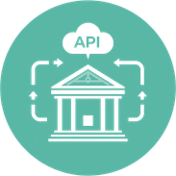
FUTURE ENHANCEMENTS
Mobile App Development: Extend the MERN Stack Expense Tracker to native iOS and Android platforms, enabling users to manage finances, log expenses, and receive alerts on the go with a seamless mobile experience.
AI-Driven Predictions & Advice: Integrate machine learning models to analyze spending patterns, forecast future expenses, suggest budget optimizations, and provide personalized financial advice based on user behavior.
External Banking API Integration: Connect directly with banks and financial institutions via open banking APIs to auto-import transactions, sync account balances in real time, and eliminate manual data entry for a fully automated finance hub.

Slide 53
SUMMARY & KEY TAKEAWAYS
All-in-One Finance Platform: A comprehensive solution for personal and family finance management — covering income, expenses, budgets, savings goals, transactions, and collaborative family wallets in a single unified application.
Automation, Collaboration & Analytics: Empowers users with recurring transaction automation, real-time budget alerts, expense splitting, detailed reports, and exportable analytics — enabling smarter, data-driven financial decisions.
Built on Modern MERN Stack: Leverages MongoDB, Express.js, React.js, and Node.js to deliver a scalable, responsive, and high-performance application with a clean modern UI and robust backend architecture.

Slide 54
THANK YOU!
Presented by Hannah Porter | Open for Questions, Demo Requests & Collaboration

